Slide 1

Mastering Market Cycles
Bali Bitcoin Meetup Marvin F. L. Hansen
Notes:
Link to download slides: https://ufile.io/mnkta

Slide 2


News
We got a logo
Thanks to Chedli
We got a guest speaker today
Thanks to Julius

Slide 3
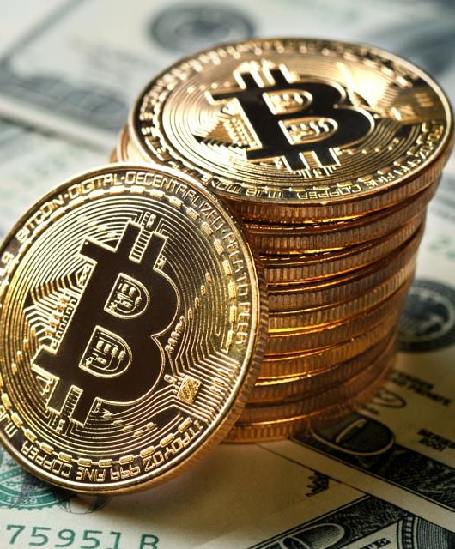
MISSION
Mission: “Help you to succeed financially!”
Goals:
Strengthen understanding of finances!
Practical application!
Smart investment!

Slide 4
Overview
Into: The Fiat Money Problem
Part I: Financial Markets (Marvin)
Land & Rent
Real estate market circle
Anatomy of a market crash
The depression of 2026
Part II: Crypto Regulations (Julius)
Crypto regulation; who creates it and how is it enforced?
What aspects of crypto will be regulated/restricted?
What does this mean for you and your crypto portfolio?

Slide 5
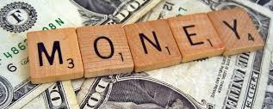

Slide 6
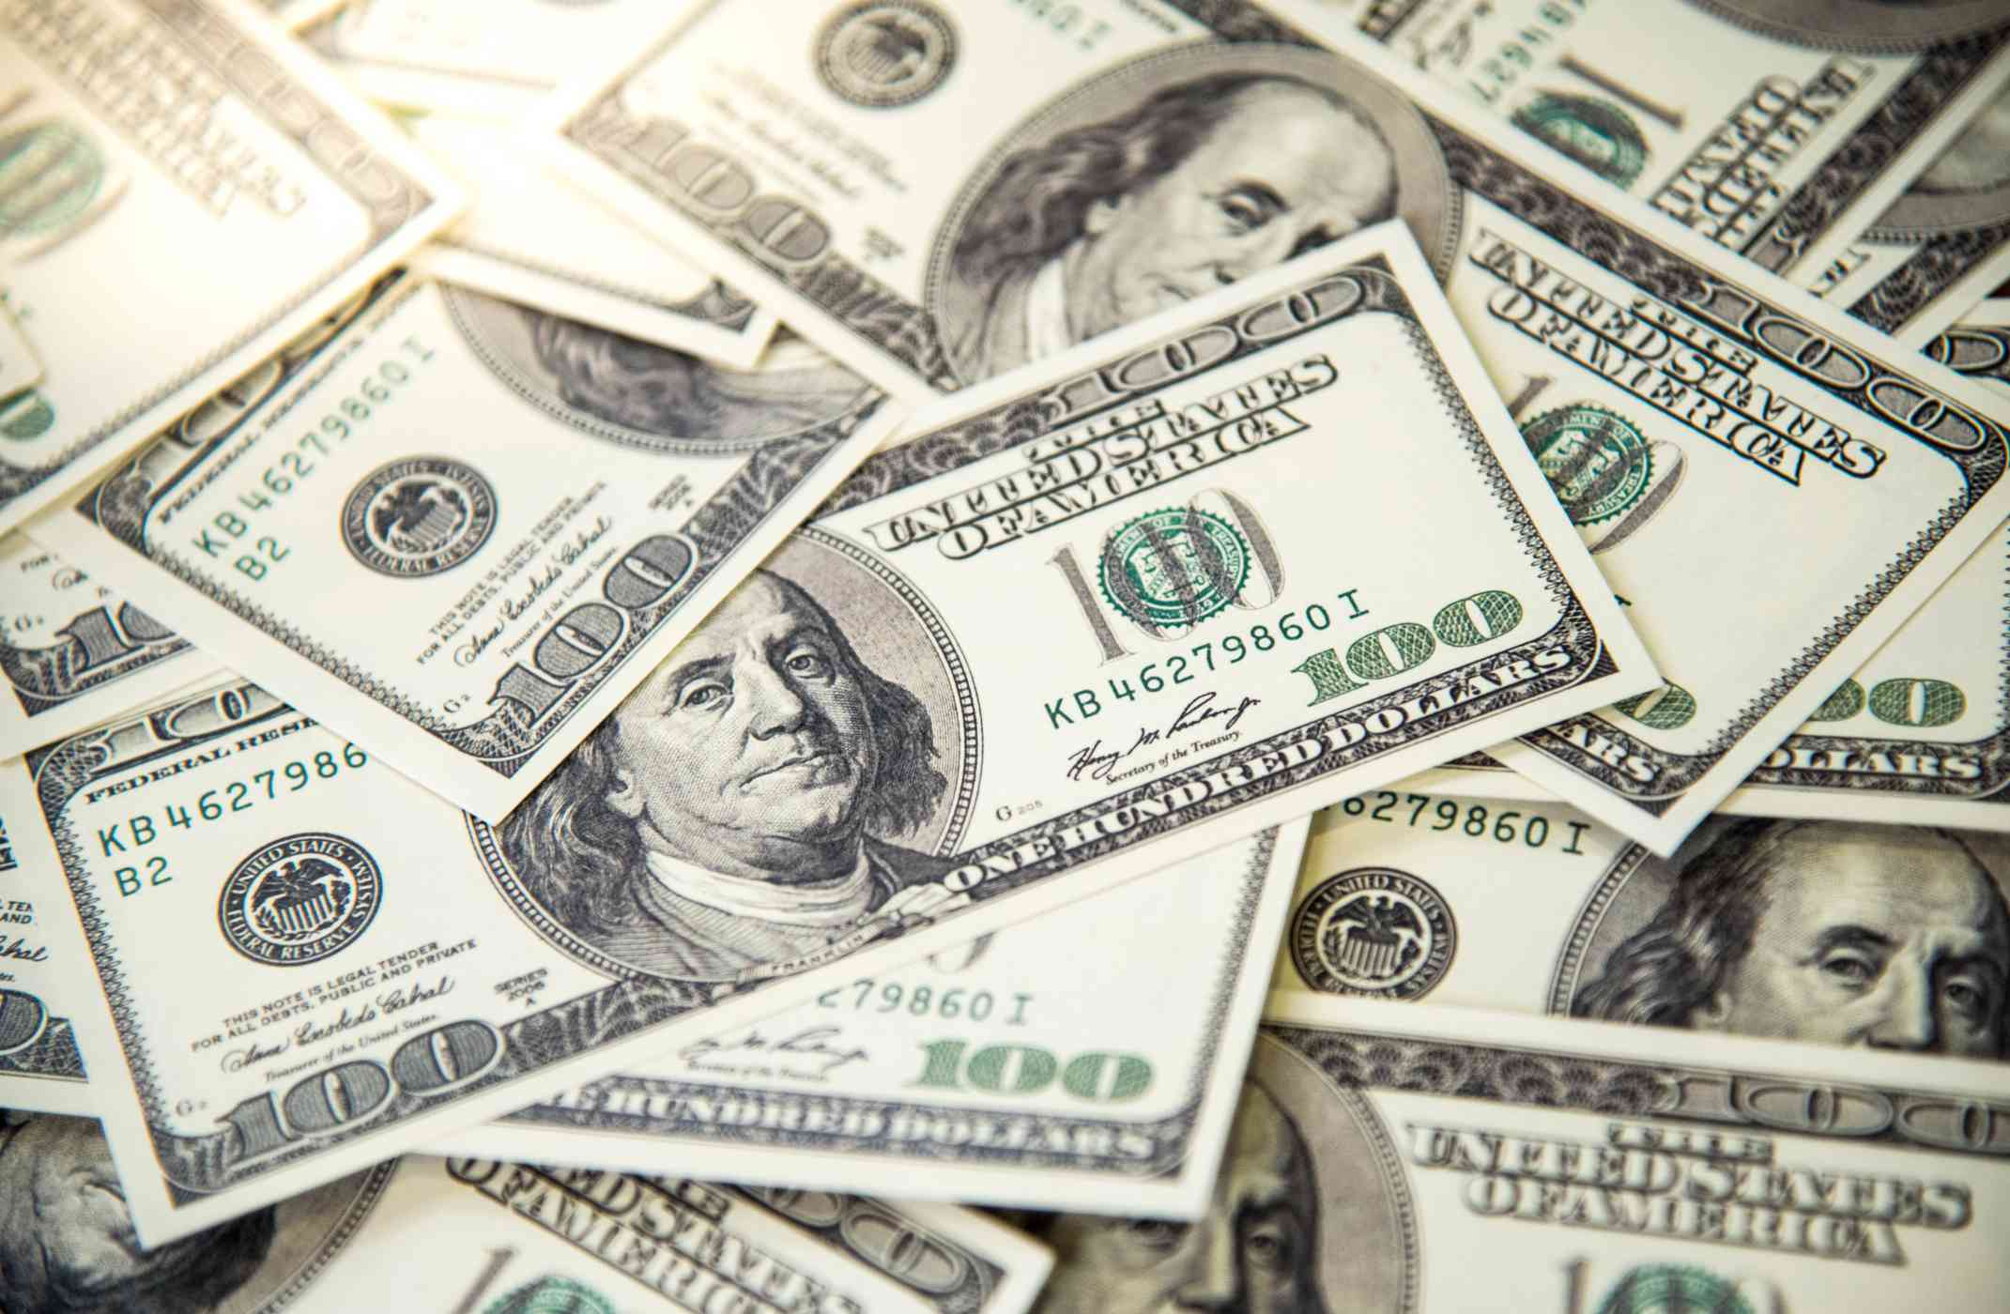
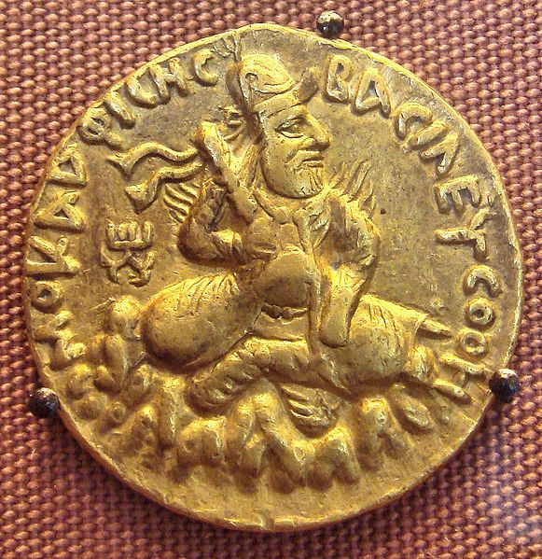
Two kinds of money
Commodity Money
Fiat Money
Money whose value comes from a commodity of which it is made!
Intrinsic value
Rare: hard to mine, or very difficult to acquire
Worth what people agree to pay!
Examples:
Gold coins
Rare spices
Silk, Jade etc.
Money created by Government through a legal degree
Zero intrinsic value
Gov. just prints it as needed
Worth what people believe its worth measured by the economic strength of the issuing country
Notes:
https://www.powercoin.it/en/cit-coin-invest-ag/5439-inca-sun-god-1-oz-silver-coin-5-palau-2021.html?gclid=EAIaIQobChMIkYexucK28AIVjhBgCh1UIAH-EAQYAyABEgIz1_D_BwE

Slide 7
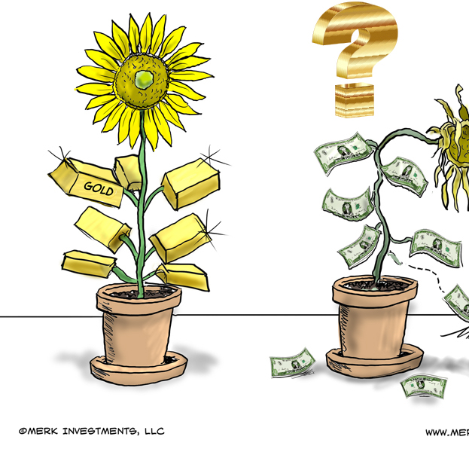
Fiat Money Problem
Printing too much money makes less valuable (inflation)
Not backed by anything else than public trust in the Government. Brexit & GBP....
Foreign Exchange Rates (Forex) swing widely during turmoil. Turkey & Lira…
Cash a lot less valuable than Gold!
Notes:
https://forum.vite.net/topic/2677/3-fiat-currencies-that-were-more-volatile-than-bitcoin-in-2019

Slide 8
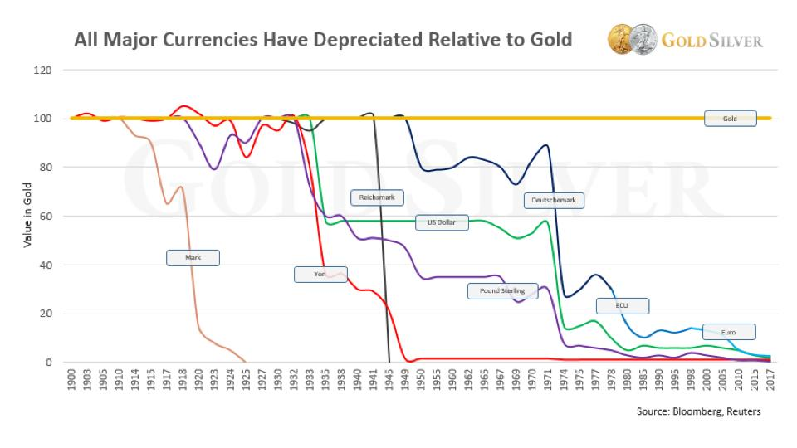
Notes:
https://www.gold-eagle.com/article/will-gold-replace-us-dollar-2020

Slide 9
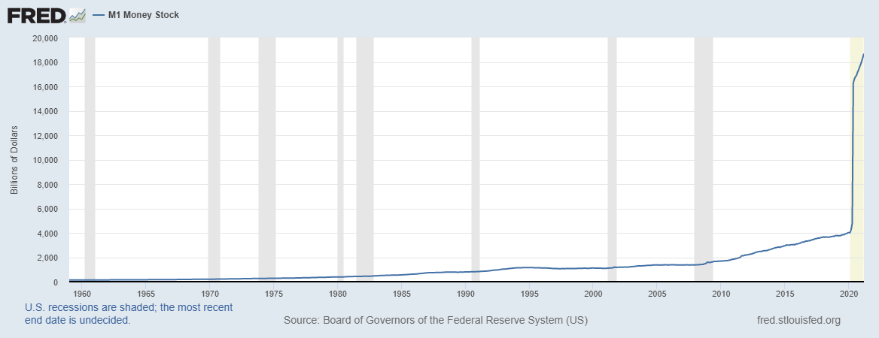
…. 12 TRILLION More $ in 2020!
Notes:
Let’s zoom in

Slide 10
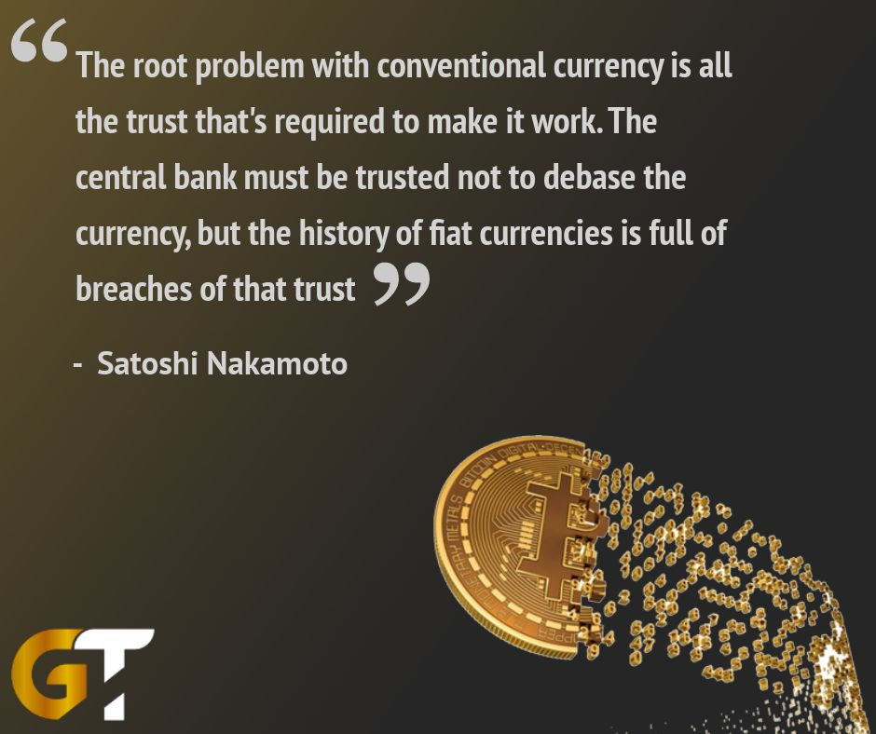

Notes:
https://twitter.com/goldtelegraph_/status/986715688717901824

Slide 11
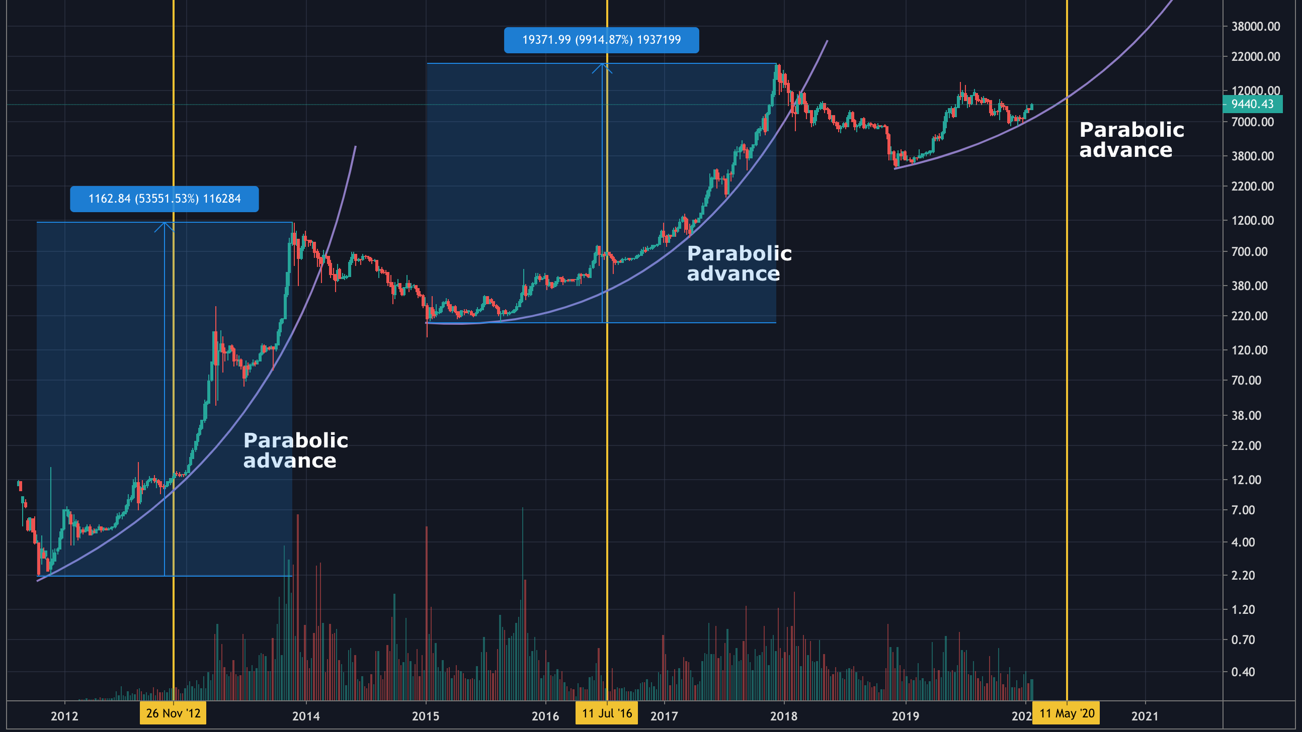

Slide 12

Summary
More money printed than ever in the history of mankind
Money loses more and more value
No bank saving possible because interest rates are about zero
The Fed, essentially, destroys the value of your hard-earned cash!
BTC acts more of a value store akin to GOLD but also increases in value due to decreasing supply

Slide 13
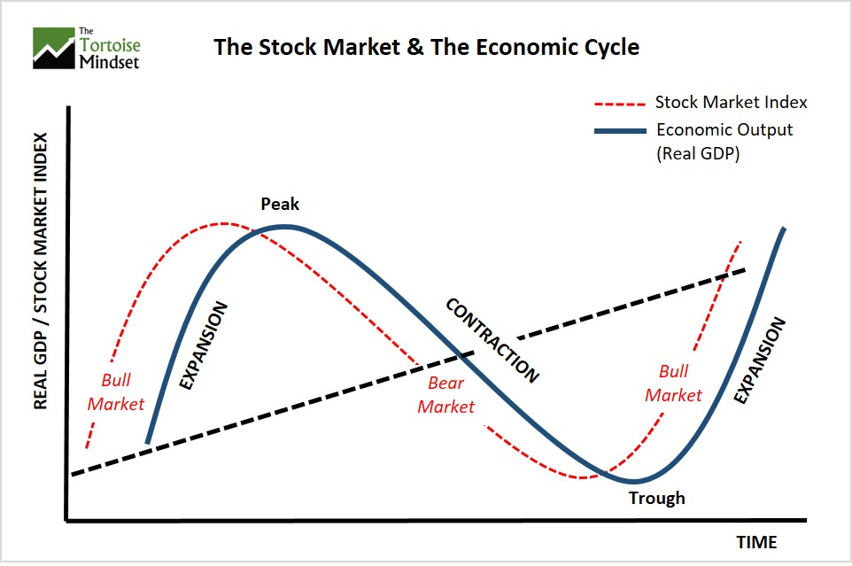
Market Cycle

Slide 14
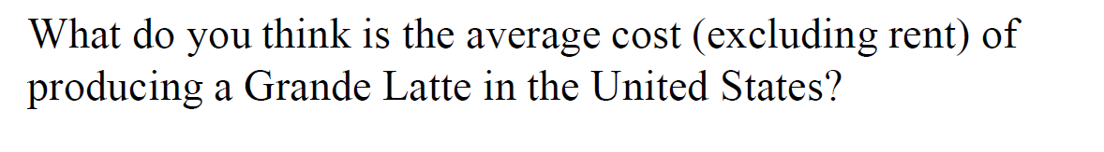

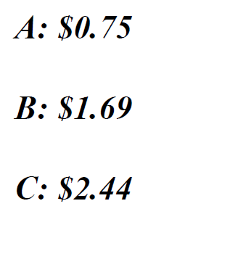
Start with a coffee…

Slide 15
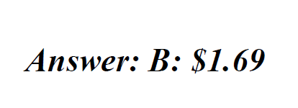
Start with a coffee…

Slide 16
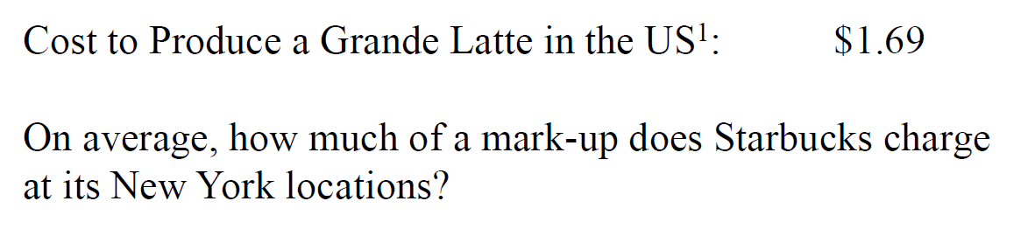
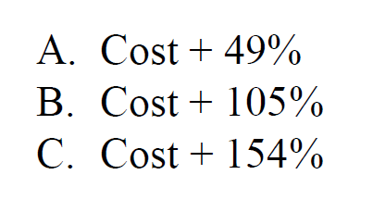
Start with a coffee…

Slide 17
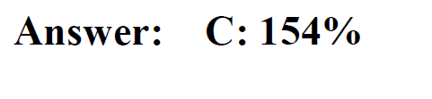
Start with a coffee…

Slide 18
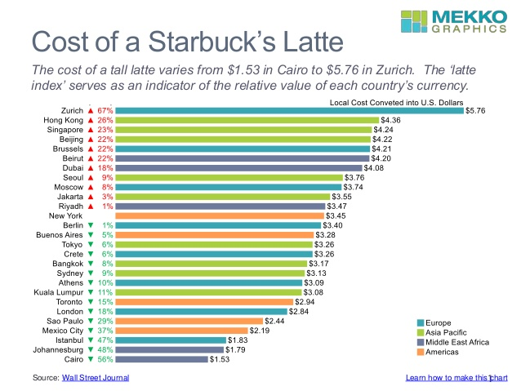
Crazy…?

Slide 19
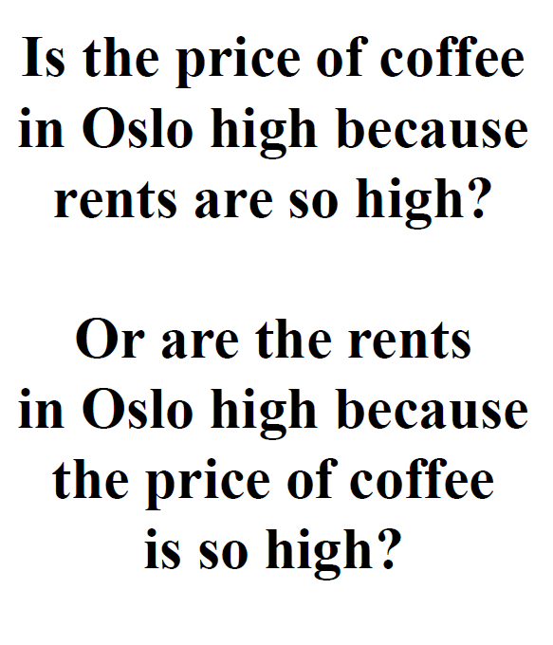
Why?

Slide 20
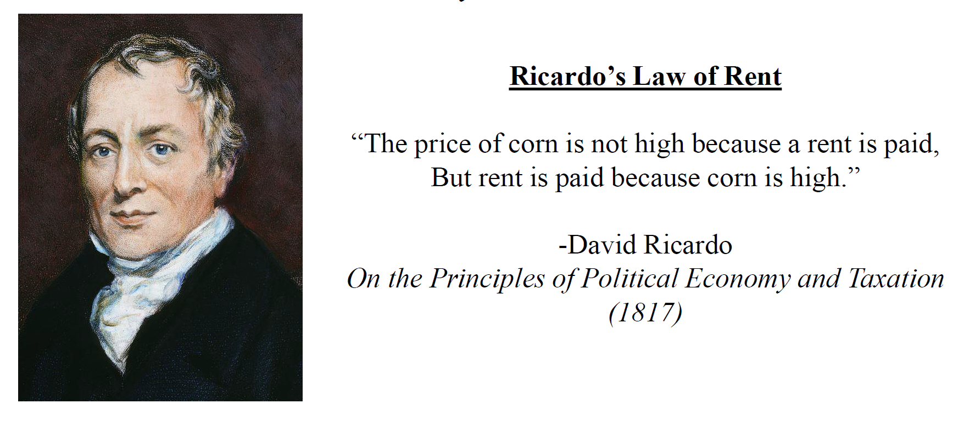

Slide 21
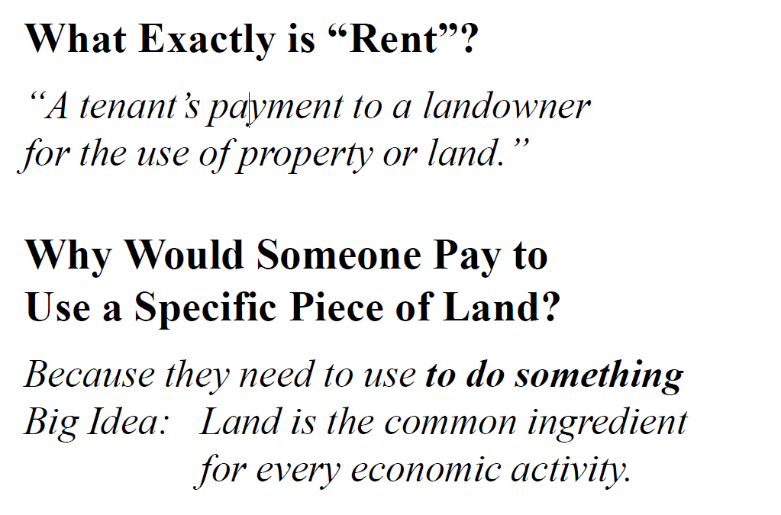
Land & Rent

Slide 22
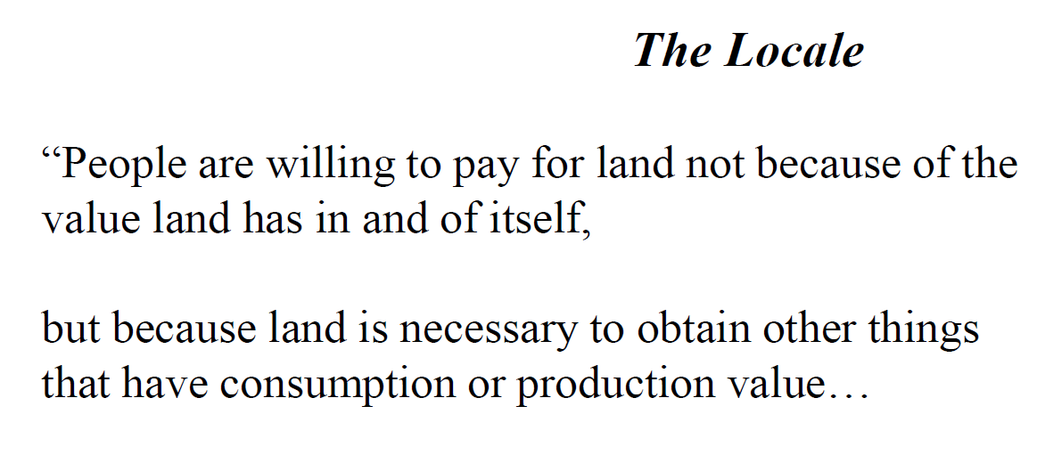
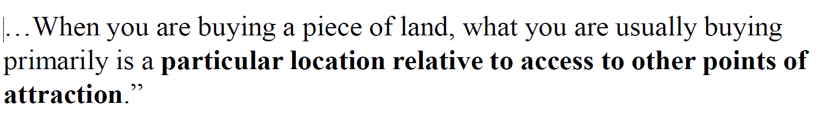
Land & Rent

Slide 23
Pricing Power
Rent is determined by 3 components:
Attractiveness of the location
Bali vs. Bronx
Scarcity
Beach front vs. Rice field villa
Productivity
Farming: Harvest per acre Business: Centrality i.e. no commuting (CBD)

Slide 24
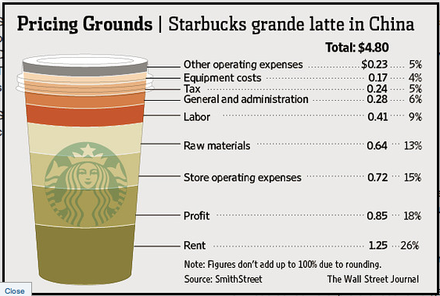
Rent eats most profit(!)

Slide 25
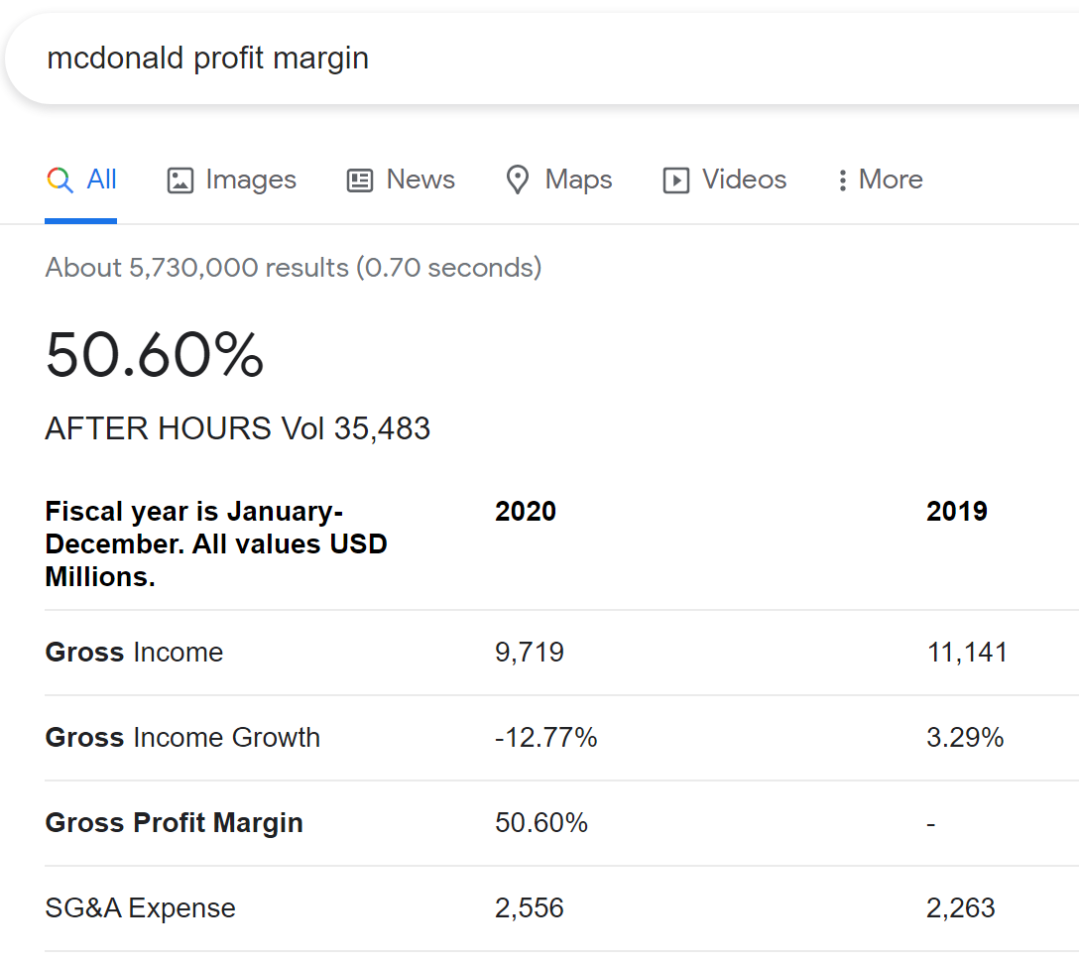
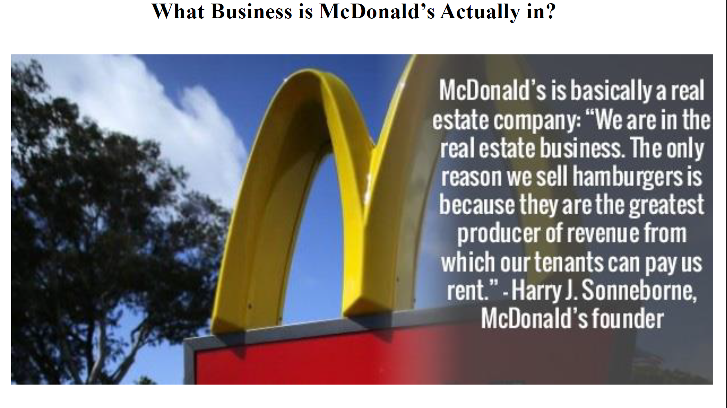




Rent makes insane profit(!)

Slide 26
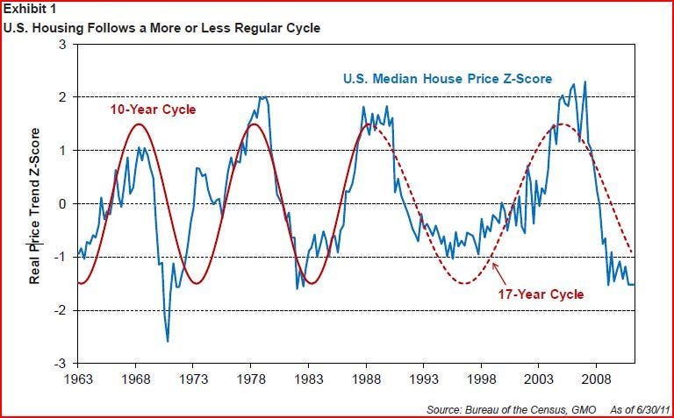
Real estate is basically a cyclical market

Slide 27
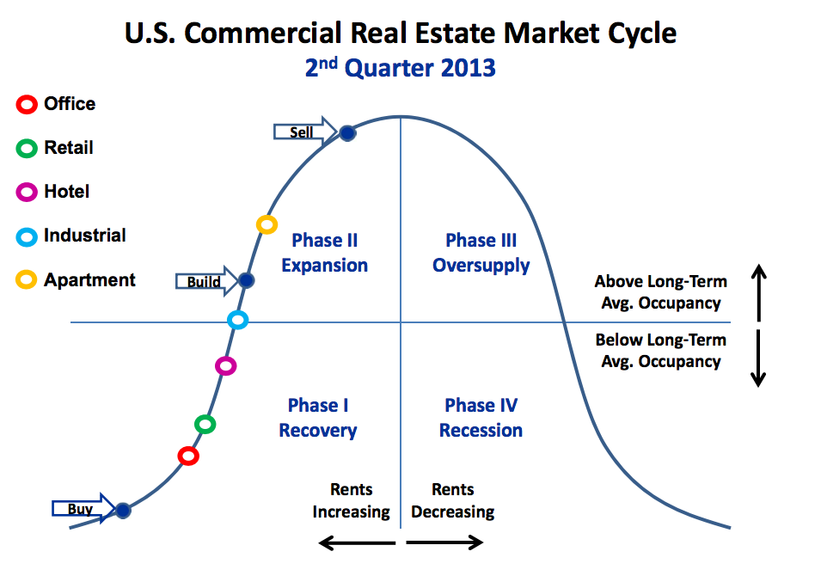
Master Real Estate Cycle

Slide 28
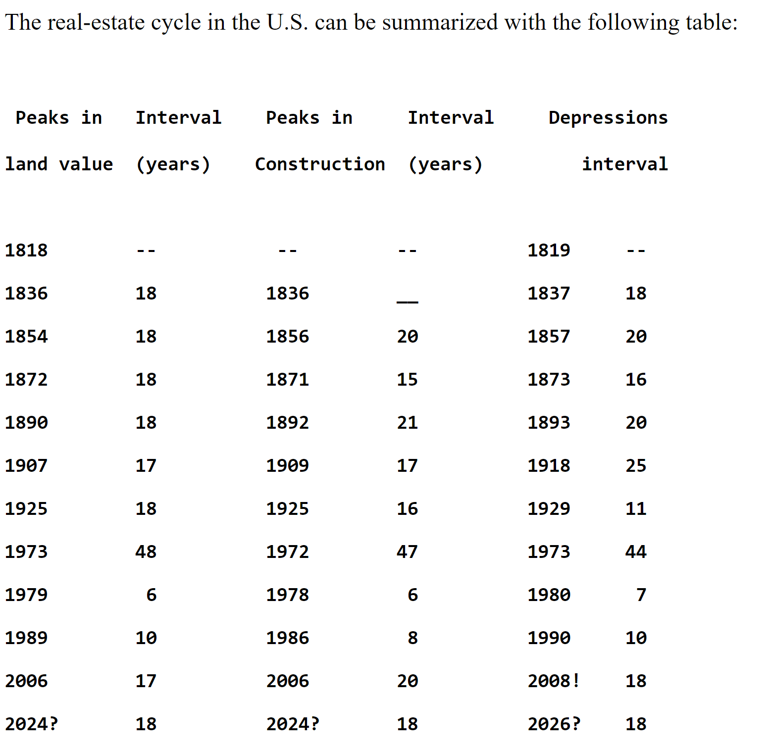




Timing of the market cycle
Notes:
Table by Fred Foldvary, Economist, San José State University
http://foldvary.net/works/cycle.html

Slide 29
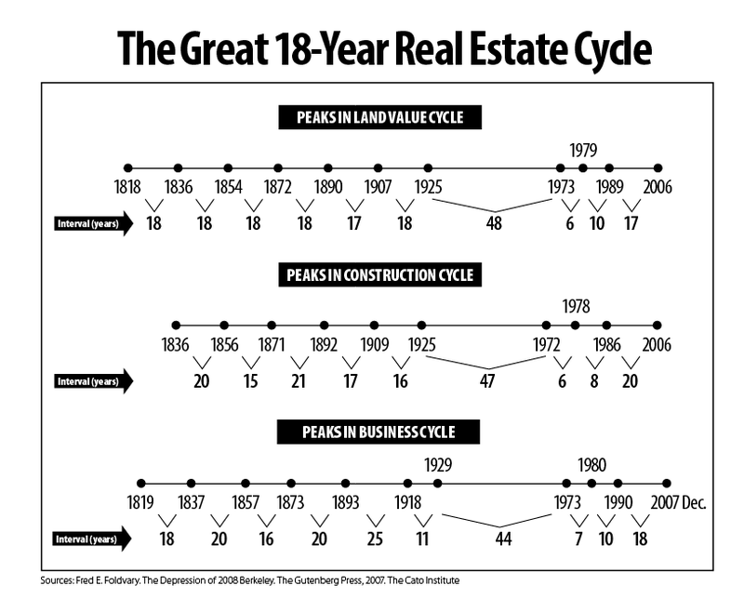
Timing of the market cycle
Notes:
Table by Fred Foldvary, Economist, San José State University
http://foldvary.net/works/cycle.html

Slide 30
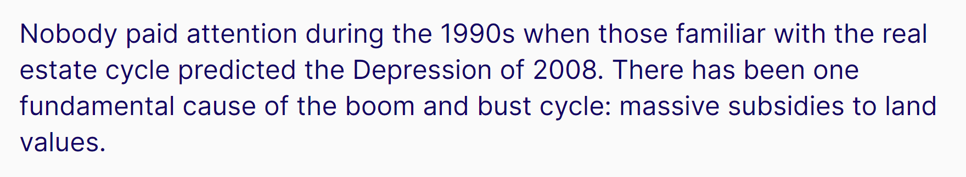
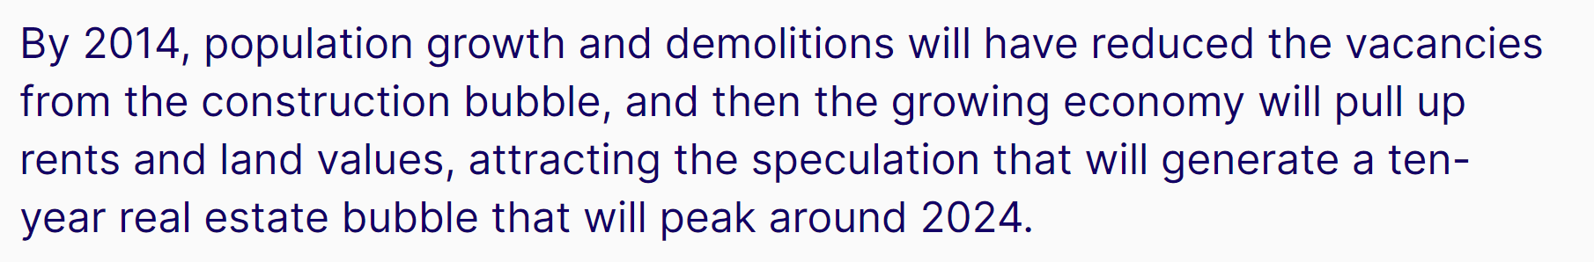
For real?
Notes:
https://www.progress.org/articles/the-depression-of-2026

Slide 31
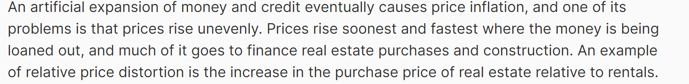
2026 For real?
Notes:
Table by Fred Foldvary, Economist, San José State University
http://foldvary.net/works/cycle.html

Slide 32
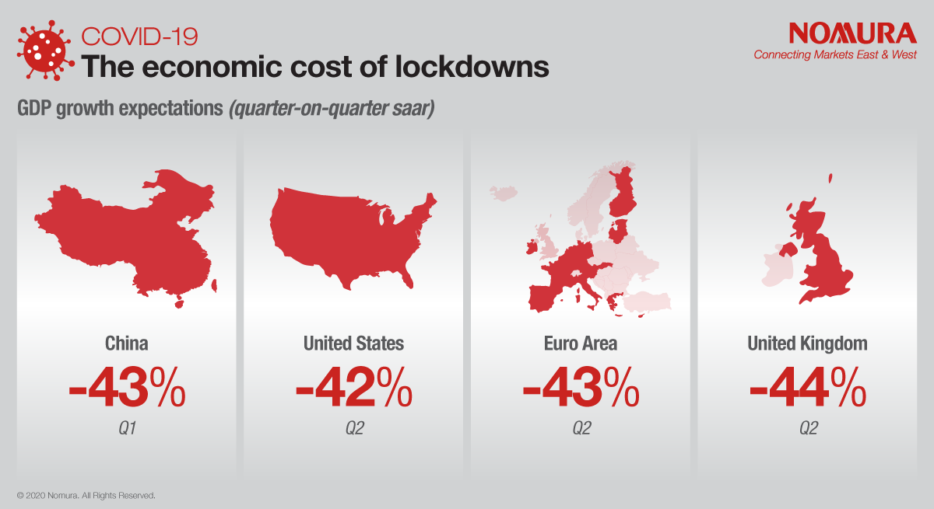
2026 For real?
Notes:
Table by Fred Foldvary, Economist, San José State University
http://foldvary.net/works/cycle.html

Slide 33
Anatomy of a market crash
Systematic shock causes increse in excess money Covid 2020 -203?
Excess money supply will be pumped into real estate 2021 - 2021
Real Estate enter Hyper-supply ~2024
Real estate market crashes ~2025 / 2026
Stock market follows within 6 months

Slide 34
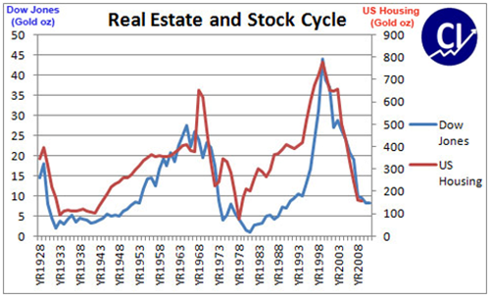
Real Estate vs Stock Market

Slide 35
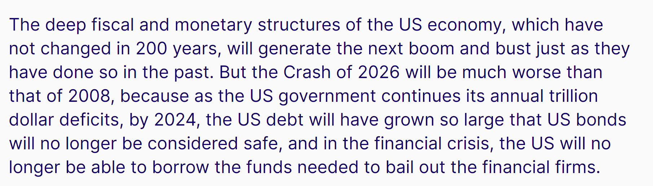
The Depression of 2026
Notes:
https://www.progress.org/articles/the-depression-of-2026

Slide 36
2021 - 2024
Prepare for the depression of 2026:
Get out of the USD / EUR -> Inflation
Get out of any debts
Invest into store of value
Land, real estate
Gold & Silver
Bitcoin & Crypto
For business, do anything online

Slide 37
Conclusion
Depression of 2026 already in the making
Inflation & Gov. rising with peak ~2024
Get out of currencies and move into store of value to preserve your economic power

Slide 38
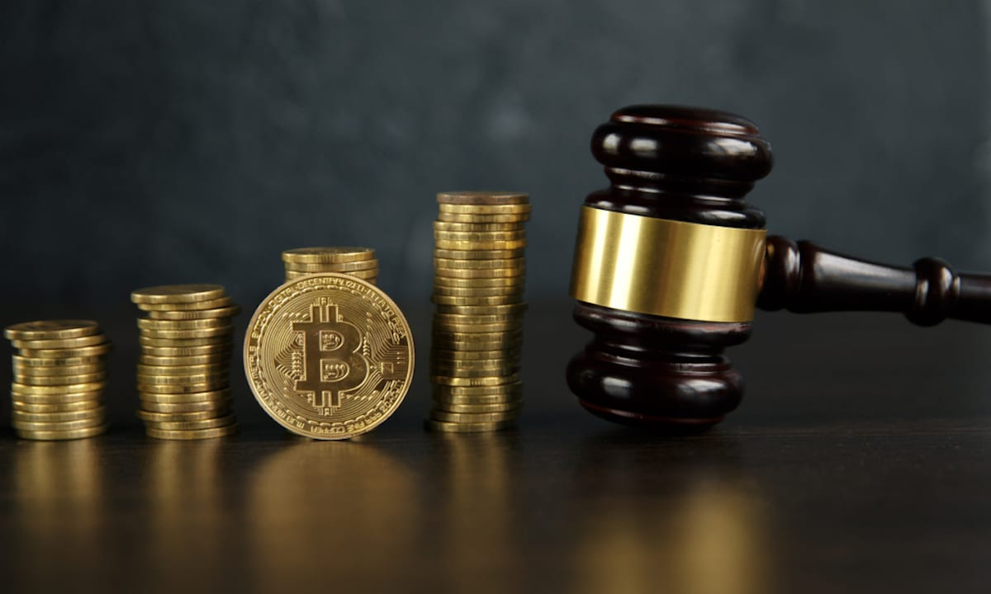
Crypto Regulations
Guest Speaker Julius van der Beek

Slide 39

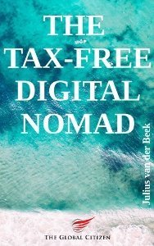
Julius van der Beek
Travelled 50(!) Countries
Digital Nomad since 2014
Wrote the “Tax Free Digital Nomad”
Advisor for tax & financial regulations
Web: www.theglobalcitizen.co

Slide 40


Q & A

Slide 41

Next Events
No further meetups in June(!)
July/3: Building Wealth With Crypto

Slide 42



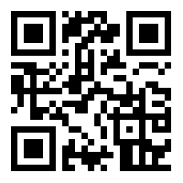
Community
https://t.me/joinchat/2T6yvFcokRQ3ZDQ0
/ Bali Bitcoin

Slide 43


